Slide 1

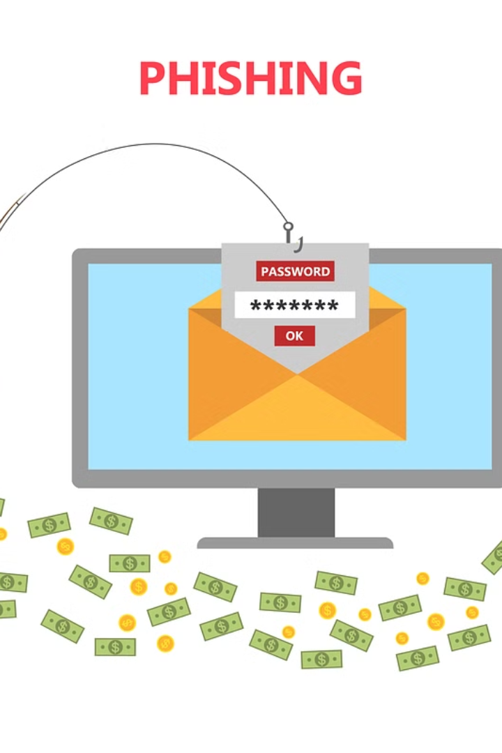
Introduction to Phishing Attacks
Phishing attacks are a type of cybercrime that aims to trick users into revealing sensitive information, such as login credentials, by disguising as a trustworthy entity.

Slide 2

What is Phishing?
1
Social Engineering
2
Impersonation
Phishing involves psychological manipulation to deceive individuals into taking specific actions.
Attackers pretend to be a legitimate organization via emails or websites.
3
Deceptive Tactics
They use fake communication to extract sensitive information.

Slide 3
Common Types of Phishing Attacks
Email Phishing
Spear Phishing
Clone Phishing
Phishing attempts conducted through deceptive emails containing malicious links or attachments.
Targeted attacks on specific individuals or organizations, often using personalized information.
Attackers create a duplicate of a legitimate email and replace its content with malicious links or attachments.

Slide 4

Recognizing Phishing Emails
1
Spelling and Grammar
2
Suspicious Links
3
Urgency and Threats
Scammers often make mistakes in emails such as spelling errors or awkward grammar.
Hover over links to check if they direct to unexpected websites.
Phishing emails often demand immediate action or threaten dire consequences if ignored.

Slide 5


Identifying Phishing Websites
SSL Certificates
Secure Connection
Look for SSL certification in the website's URL, indicated by a lock icon.
Check for "https" rather than "http" in the website's URL.

Slide 6

Avoiding Phishing Scams
Vigilance
Security Software
Be cautious and verify the authenticity of all incoming emails, links, and websites.
Install and regularly update anti-phishing and security software.
Two-Factor Authentication
Enable 2FA on all accounts for an added layer of protection.

Slide 7

Best Practices for Protecting Against Phishing Attacks
1
Employee Training
Regularly conduct education and training programs to raise awareness about phishing attacks.
2
Email Filters
Implement strong filters to detect and block suspicious emails.
3
Intrusion Detection
Utilize advanced intrusion detection techniques to identify phishing attempts.

Slide 8



Conclusion and Next Steps
Educate
Regular Assessment
Collaboration
Continuously educate and update users about evolving phishing tactics.
Conduct regular evaluations and simulations to test the organization's security practices.
Encourage collaboration between security teams and end-users to share and act on potential threats.

